Slide 1
MYOFASCiaL RELEASE
Performing Arts Physical Therapy

Slide 2
Objectives
To explain what fascia is.
To increase understanding of how fascia becomes tight.
To describe what occurs with a Myofascial Release (MFR).
To state the goal of MFR.
To point out candidates for MFR.
How physical therapist can evaluate for Myofascial restrictions.
To list the different types of release used by the therapist.
To narrate how MFR is performed.
To find what current research is saying about MFR.
To call the need for future research.
To tell how patients will receive MFR at Performing Arts Physical Therapy (PAPT).

Slide 3
Fascia ^{1,2}
Fascia is specialized connective tissue (CT) that surrounds every muscle, nerve, bone, blood vessel, and organ at cellular levels.
Fascia serves a a lubricant to allow motion and provides form and structure for the body.
The functions of fascia include:
Supporting vessels and nerves
Allowing muscles to move over one another
Providing stability and contour as well as fluidity and lubrication
Participating in reflex loops from Paccinian corpuscles afferent fibers
Contracting and relaxing to respond to deformation
There are layers of fascia:
Superficial – thin elastic fibers under the surface of the skin
Deep – to separate muscles and organs for contour of the body
The deepest layer is the Dura Mater which surrounds the brain.

Slide 4
Connective Tissue ¹⁻³
CT helps to define the body to ensure efficiency of motion.
CT is an adaptive tissue that responds to trauma to protect the body.
CT is made of:
Collagen provides support, strength, stabilization, and definition.
Elastin provides dynamic flexibility and absorbs tensile forces.
Ground Substance surrounds every cell to provide cushion and lubrication.

Slide 5
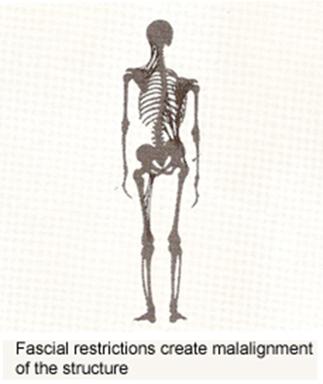
Fascia Restrictions ^{1,3,4}
Fascia tightens after trauma occurs to it.
Commonly during one single event
or micro-traumas overtime.
The body’s reaction to trauma:
Collagen becomes dense and fibrosis.
Elastin loses its resiliency.
Ground substance solidities.
Fascial restrictions create abnormal strain patterns resulting in compression of joints and musculature producing pain and imbalances.
These restrictions can create up to 2,000 pounds per a square inch of pressure on pain sensitive structures of the nervous system.

Slide 6
Causes of Myofascial Dysfunction ^{1,3-5}
Back Pain
Jaw Pain ( TMJ)
Disc Problems
Headaches
Sports Injuries
Whiplash
Fibromyalgia
Neurological
Dysfunction
Chronic Pain
Carpal Tunnel
Adhesions
Lymphedema
Strains
Migraines
Chronic Fatigue
Adhesions
Neck Pain
Scoliosis
Sciatica
Sprains
Hypermobility
Immobilization
Injections
Traumas
Stressors
Disease
Scars
Vulvodynia
Inflammation
After Surgery
Pelvic Floor Pain
Urinary Incontinence
Infertility Problems
Mastectomy Pain
Urinary Urgency
Endometriosis
Interstitial Cystitis
Problematic Breast
Implant/Reduction
Menstrual Problems
Urinary Frequency
Painful Intercourse
Coccydnia
Episiotomy Scars

Slide 7
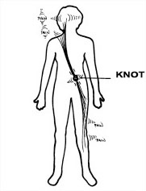
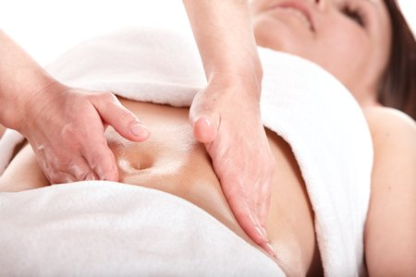
Goals of Myofascial release ¹⁻⁵
Relieve fascial restrictions to normalize health and tension of the body.

Slide 8
Myofascial release ^{1,2,4,5}
MFR is a manual therapy technique where the fascia is mobilized to provide relief of restriction and pain for the patient.
The release takes can take 90-120 seconds or until a reaction from the patient has occurred.
Reactions include: sighs, increased heart beat, decreased muscle tension, decreased pain, mechanical pressure on the therapist, vasodilation, heat, overall relaxation or an emotional outburst.
The result is a softer, more pliable, and elongated tissue.

Slide 9
Types of MFR ^{2,6}
Cranial-Cervical Junction
Temporal (Jaw) fascial release
Suboccipital release – Behind the head
Hyoid System
Thoracic Inlet Diaphragm
Top hand on inlet; bottom at C7/T1
Radioulnar Release
Carpal Tunnel Release – Wrist
Thoracolumbar opening technique
Abdominal Respiratory Diaphragm
Top hand base of rib cage; bottom T12/L1
Pelvic Diaphragm
Top hand at pubic bone; bottom at sacrum
Anterior Iliosacral Joint Release
Posterior Iliosacral Joint Release
Sacral Plexus Release
Patellar Release
Tibiofibular release
Extradural or nerve impingements
Lumbosacral Decompression – Low back
Muscle belly technique
Scar tissue release

Slide 10
Contraindications for Myofascial release ⁴
Contraindications include but are not limited to patients with:
Malignancy
Aneurysm
Acute rheumatoid arthritis
Advanced diabetes
Severe osteoporosis
Healing fractures
Please also note that there may be an initial feeling of soreness after treatment as the body accommodates to this new balanced state after it was used to the unbalanced state prior.

Slide 11
Procedures for treatment ^{1-5,7}
Evaluate the patient.
Identify posture or range of motion imbalances.
Find the location of restriction.
Relieve biomechanical dysfunctions as well as trigger points if necessary.
Recheck imbalance.
Continue to treat with MFR.
Recheck imbalance.
Teach self-MFR techniques.
Strengthen and educate patient to ensure imbalance does not reoccur.

Slide 12
Myofascial Evaluation ²
Static posture
Leg length
Pelvic symmetry
Sacral positioning
Dynamic Posture
C/s Rom
B Shoulder Abd
Trunk Mobility
LE ROM
Hip ext
Knee Flx
Palpation
Superior – inferior glides
Medial – lateral glides
Clockwise –Counter-clockwise glides
Joints: Compression - distraction

Slide 13
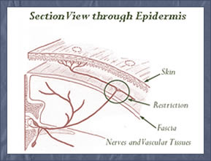
Progressions of Myfascial Release
Proximal to distal
Most severe imbalance/restriction/asymmetry to less severe
Static before dynamic imbalance

Slide 14
Myofascial Release ²
Based on evaluation of Myofascial dysfunction start with point of greatest restriction.
Apply pressure to area with hands.
One hand on top of the area of the body, the other underneath.
Both hands on the same surface in opposite directions.
Stack all three tested planes one at a time.
Pick one of each based on which direction of the two had the greatest ease of motion.
For all joints apply distraction or compression before stacking on planes.
For joints of the lower extremity only use one plane at a time.
Hold fulcrum there until tension dissipates.

Slide 15
Muscle belly technique ²
Place both hands side-by-side on the muscle belly.
Grip belly.
Stack 3 planes.
Maintain fulcrum until release.
For:
Quadriceps
Hamstrings
Gastrocnemius
Tibialis Anterior
Deltoid
Biceps
Brachioradialis

Slide 16
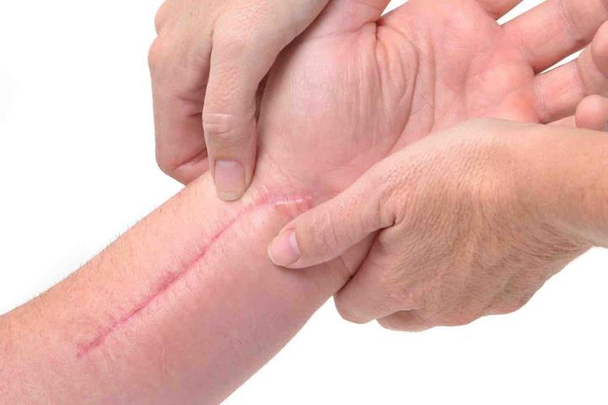
Scar release technique ²
Place pads of fingers of both hands along the length of the scar.
Use as many fingers will fit on the length of the scar.
Apply pressure.
Maintain pressure while moving in the 3 planes of ease.

Slide 17
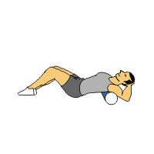
Best When Used with Physical therapy treatments ^{2,3,7-11}
Perform MFR after biomechanical dysfunctions have been treated with muscle energy or mobilizations.
Perform MFR after calming severe muscular spasms using techniques such as Strain Counter-Strain or Trigger Point Release.
Teach self-MFR techniques such as with pressure or foam rolling.
Strengthen and educate to ensure the dysfunction does not reoccur.

Slide 18
Therapeutic Effects & Benefits of Myofascial release ^{1,6-9}
Decreased pain
Improved blood flow
Improved alignment
Improved joint function
Improved sleep
Improved quality of life
Decreased anxiety
Decreased fatigue
Decreased stiffness
Decreased muscle activity & vigor after stressful exercise or performance.

Slide 19
Length of Effects ^{6,10}
MFR works to change the course of bodily functions to reset imbalances to progress in a balanced state.
Effects of MFR can last
Until motion causing trauma is repeated.
Research has found up to a 6 month post treatment.
Research also shows that benefits can be achieved with a physical therapy visit once a week.
Further lasting benefits are noted when self-MFR is performed.

Slide 20
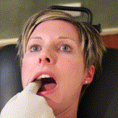
Research for MFR: Intraoral MFR for TMJ¹⁰
Intraoral MFR for chronic TMJ pain has found significant results in pain and opening when used with self-MFR treatments 1 year later.

Slide 21
Research for MFR: Hypermobility syndromes^{9,12}
People with hypermobility syndromes have global dysfunction.
Global dysfunction = increased myofascial restriction.
It is important to find the most prevalent restriction to release.
Care after the MFR is performed must be done by strengthening to ensure that the dysfunction does not reoccur due to the hypermobility.

Slide 22
Research for MFR: Chronic Pain & MFR^{6,13}
Research states that patients with fibromyalgia had a significant reduction in pain after MFR.
MFR provides a consistent pain reduction for patients with fibromyalgia when compared to massage alone.

Slide 23
MFR at PAPT
Performing Arts Physical Therapy will aim to address your myofascial restriction to provide you with relief from your pain. We will help you return to the performance of your life the way you planned with some of our tips and tricks to keep it from reoccurring.
Any questions please direct them to: info@performingartspt.com.

Slide 24
References
Barnes MF. (1997). The basic science of myofascial release: morphologic change in connective tissue. J Body and Move Therap. 1;(4): 231-238.
Geeza, G. (2012). Myofascial Release Module: Lecture Notes. U of Scranton.
Barnes JF. (1996). Performance Injuries - Fascia: The Body's Shock Absorber. PT Today.
Hughes M. (2012). Myofascial Release (MFR): An overview. Hospital of Special Surgery. www.hss.org.
Barnes JF. (2005). Scientific Rationale for MFR. Myofascial release treatment centers and seminars.
Castro-Sánchez AM, Matarán-Peñarrocha GA, Granero-Molina J, Aguilera- Manrique G, Quesada-Rubio JM, & Moreno-Lorenzo C. (2010). "Benefits of Massage-Myofascial Release Therapy on Pain, Anxiety, Quality of Sleep, Depression, and Quality of Life in Patients with Fibromyalgia." National Center for Biotechnology Information. U.S. National Library of Medicine, 28 Dec. 2010.
Barnes JF. (2005). Scientific Rationale for MFR. Myofascial release treatment centers and seminars.
Arroyo-Morales M, Olea N, Martinez MM, Hidalgo-Lozano A, Ruiz-Rodriguez C, & Diaz-Rodriguez L. (2008). Psychophysiological Effects of Massage-Myofascial Release after exercise: A randomized sham-control study. J Alt and Complem Med. 14;(10); 1223-1229.
Castori M. (2012). “Ehlers-Danlos Syndrome, Hypermobility Type: An Underdiagnosed Hereditary Connective Tissue Disorder with Mucocutaneous, Articular, and Systemic Manifestations,” Dermat. Vol:2012.
Kalamir A, Bonello R, Graham P, Vitiello AL, & Pollard H. (2012). Intraoral Myofascial Therapy for Chronic Myogenous Temporomandibular Disorder: A Randomized Controlled Trial. J Manip and Physiol Thera. 35;(1):26-3.
Healey KC, Hatfield DL, Blanpied P, Dorfman LR, & Riebe D. (2011). The Effects of Myofascial Release with Foam Rolling on Performance. J Stren and Cond Res. 25: S30A.
Castori M, Morlino S, Celletti C, Celli M, Morrone A, Colombi M, Camerota F, Grammatico P. (2012). Management of pain and fatigue in the joint hypermobility syndrome (a.k.a. Ehlers–Danlos syndrome, hypermobility type): Principles and proposal for a multidisciplinary approach. Am J Med Genet. Part A;158A:2055–2070.
Liptan G, Mist S, Wright C, Arzt A, & Jones KD. (2013). A pilot study of myofascial release therapy compared to Swedish massage in Fibromyalgia. J Body and Move Therap. 1360-8592.

